Slide 1
Mini shopping center database
Done by: Aldiyar Akhmediyev, se-2017.

Slide 2
Short explanation of my project
Basically, I created shopping center database by using SQL statements.
This database will be very helpful for the managers’ of shopping center and for the end users. For example, it will be very easy and fast to find specific item’s price. Or, finding something to eat etc.
I am doing my project in PgAdmin4 application using SQL statements.
My database consist of 10 tables or 3 stores: KFC, Sulpak and Pharmacy.

Slide 3
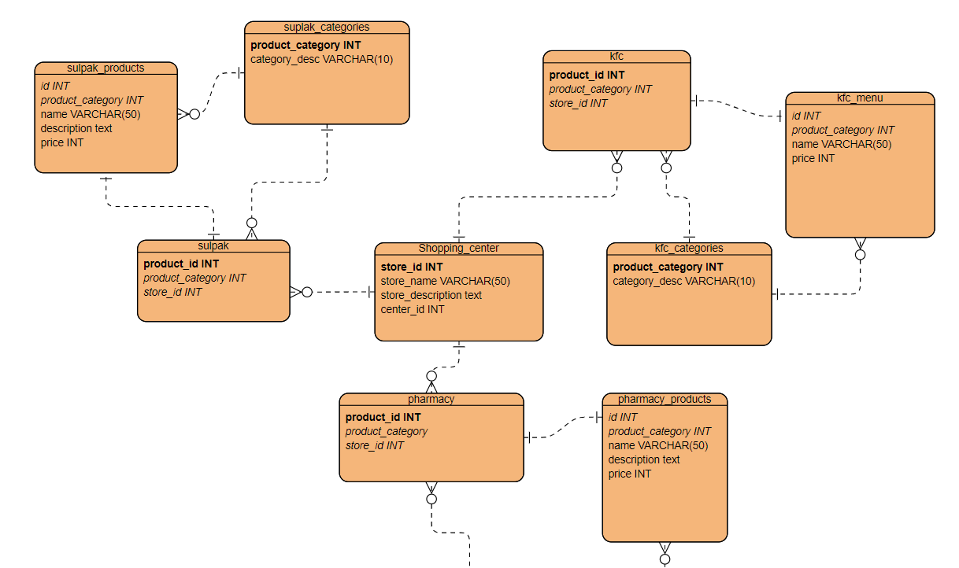
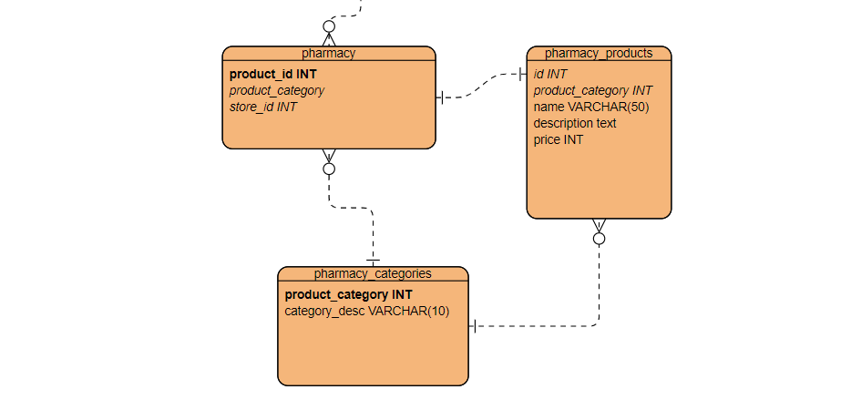
Entity-relationship diagram of my database

Slide 4
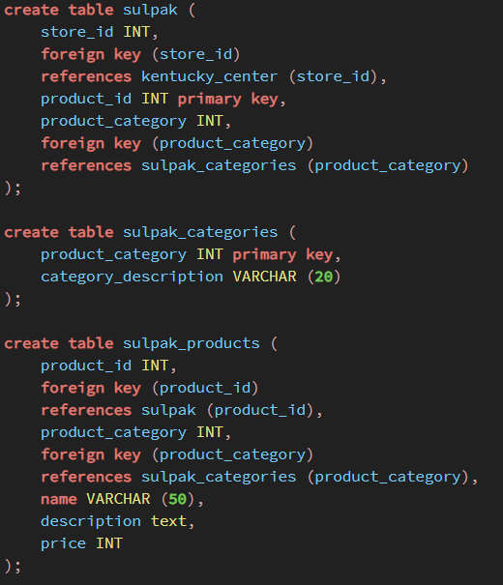
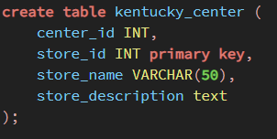
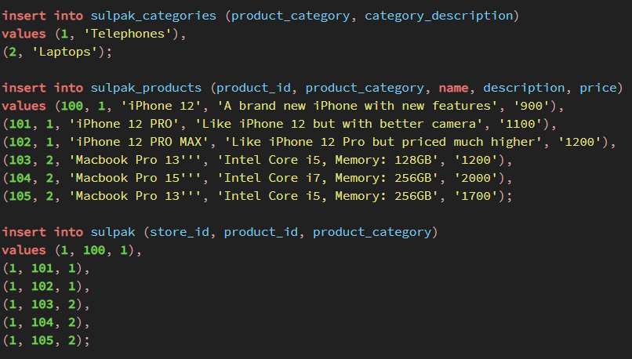
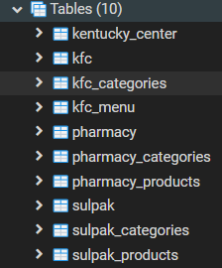

Slide 5
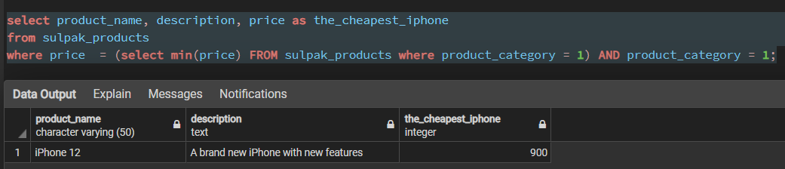
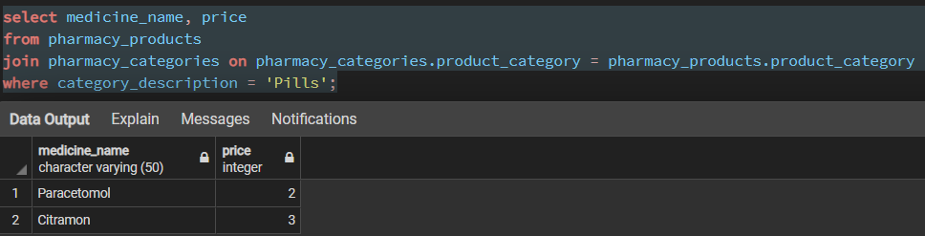
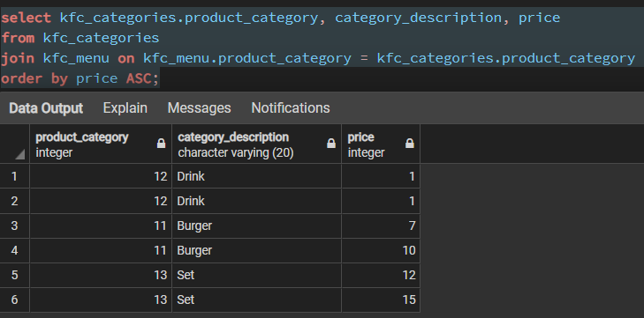
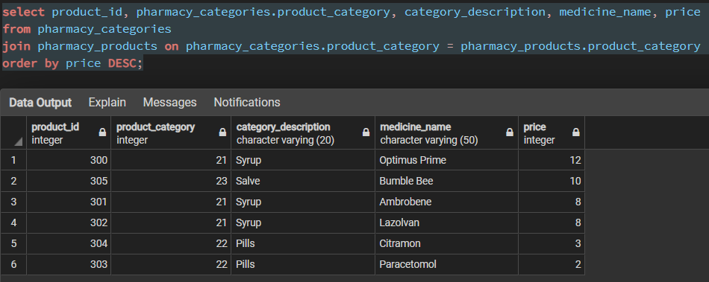
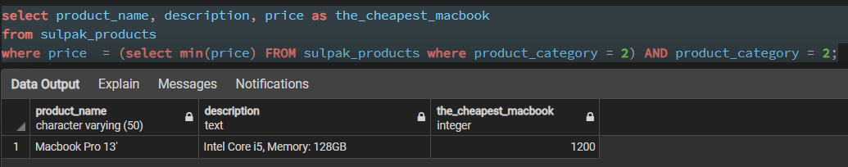

Slide 6
Thank you for the attention!!!

